Slide 1
أكـــــاديميــــة طــــويـــق
Deep Learning

Slide 2
CNN Architecture
By: Dr. Afshan Hashmi

Slide 3
Course Objectives:
Learn the purpose and working of convolutional layers, pooling layers, and fully connected layers in feature extraction and classification.
Comprehend filters, strides, padding, and activation functions (ReLU) to generate feature maps from input data.
Analyze max pooling, average pooling, and their role in dimensionality reduction and translation invariance.

Slide 4
Introduction to CNN Architecture
Convolutional Neural Networks (CNNs) are specialized deep learning models built to process visual data such as images and videos. Their unique architecture allows them to automatically extract features like edges, textures, shapes, and objects from raw pixels—without manual feature engineering.
What Makes CNNs Different?
Unlike regular neural networks (which flatten images into vectors), CNNs preserve the spatial structure of the image. This makes them more efficient and accurate for tasks like:
Image classification
Object detection
Face recognition
Medical image analysis

Slide 5
Introduction to CNN Architecture
Core Idea
CNNs are designed to learn spatial hierarchies of features:
Lower layers learn basic patterns like edges and lines.
Deeper layers combine these into complex patterns like shapes and objects.
This learning happens via backpropagation, just like in other neural networks.
Key Components of CNN Architecture:
Convolutional Layers (Feature Extraction)
Pooling Layers (Dimensionality Reduction)
Fully Connected Layers (Classification)

Slide 6
CNN Architecture Overview
Input Layer
Takes in the image (e.g., 128×128×3 for a color image).
Convolutional Layers
Apply filters (kernels) that scan the image to detect features.
Outputs a feature map.
Activation Function (ReLU)
Applies non-linearity after convolution to allow learning complex patterns.
Pooling Layer (e.g., MaxPooling)
Downsamples the feature map (reduces size and computation).
Keeps only the most important information.
Fully Connected Layer
Final layers that interpret features and make decisions (like classifying a cat or dog).
Output Layer
Usually has a softmax activation to output class probabilities.
Think of CNNs like a camera filter:
Convolution layers act like filters detecting parts of the image.
Pooling layers summarize what’s important.
Fully connected layers decide what’s in the image.

Slide 7
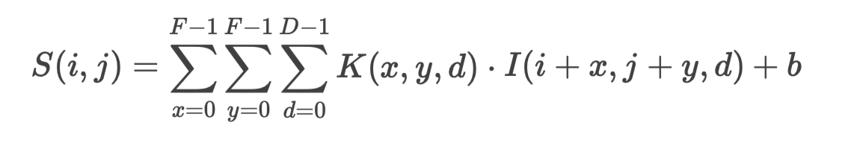
Convolutional Layers and Feature Maps
Convolutional layers are the core components of CNNs used to automatically extract visual features (edges, textures, patterns) from input images.
Convolution Operation
A filter (kernel) slides over the input image.
It performs element-wise multiplication, followed by summation.
The result is a feature map.
Filters have learnable weights, optimized during training.
Mathematical Formulation:
Given an input image I of size W×H×D (Width × Height × Depth) and a filter K of size F×F×D, the convolution operation is computed as:
where:
S(i,j) = Output feature map value at position (i,j)(i,j)
b = Bias term
The filter moves with a stride (S), which determines how many pixels the filter shifts each time.

Slide 8
Convolutional Layers and Feature Maps
Key Concepts in Convolutional Layers
(a) Stride (S)
Controls the movement of the filter.
A stride of 1 means the filter moves one pixel at a time.
A stride of 2 means it skips one pixel, reducing the output size.
(b) Padding (P)
Zero-padding adds extra pixels (usually zeros) around the input to control the output size.
Types:
Valid Padding: No padding, output size decreases.
Same Padding: Padding is added so that the output size matches input size (when stride=1).

Slide 9
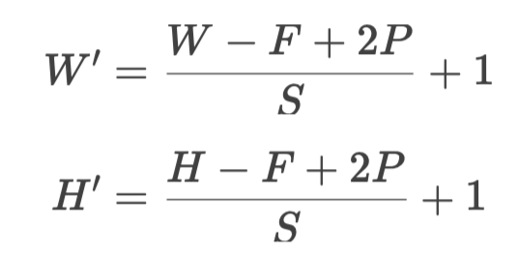
Convolutional Layers and Feature Maps
(c) Output Feature Map Size Calculation
The dimensions of the output feature map (W′×H′)can be calculated as:
Where,
W, H = Input width and height
F = Filter size
P = Padding
S = Stride
(d) Multiple Filters and Depth
Each filter produces one feature map.
If we use KK filters, the output will have depth KK.

Slide 10
Activation Functions (Non-linearity)
After each convolutional operation in a Convolutional Neural Network (CNN), we apply an activation function to the resulting feature map. This step is crucial because:
Why Apply Activation Functions?
Real-world data (like images) is non-linear in nature. Without adding non-linearity, your neural network—even a deep one—would just be a giant linear function, and no matter how deep it goes, it wouldn’t learn complex patterns.
Think of it this way:
Without activation → your CNN is just multiplying and summing → linear
With activation → your CNN can learn edges, textures, objects → non-linear features
Popular Activation Functions
ReLU
Leaky ReLU
Sigmoid

Slide 11
Activation Functions (Non-linearity)
ReLU (Rectified Linear Unit)
It keeps only important signals (positive values) and discards noise (negative values), making training faster and reducing complexity. Most widely used in CNNs.
Formula:
ReLU(x) = max⁡(0,x)
In simple words: If the input is positive, keep it. If it’s negative, change it to 0.
Input x | ReLU(x)
-5 | 0
0 | 0
2 | 2
from tensorflow.keras.layers import Conv2D, Activation
# Convolution layer followed by ReLU activation
model.add(Conv2D(filters=32, kernel_size=(3, 3), input_shape=(128, 128, 3)))
model.add(Activation('relu'))

Slide 12
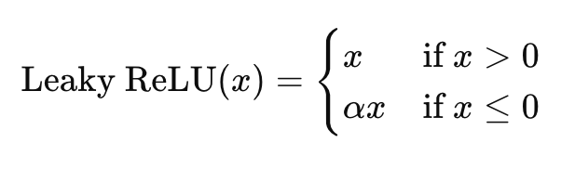
Leaky ReLu Activation Function
What is Leaky ReLU?
Leaky ReLU is a variant of the ReLU activation function that fixes one of ReLU’s main problems "dying neurons" (when neurons always output 0).
Why is it needed?
In ReLU, the output is 0 for all negative inputs. If a neuron's weights cause it to always produce negative values, it stops learning (gradient becomes zero). Leaky ReLU allows a small, non-zero gradient when the input is negative.
Leaky ReLU Formula
Where: α alpha is a small constant (e.g., 0.01)

Slide 13
Leaky ReLu Activation Function
from tensorflow.keras.layers import LeakyReLU
model.add(Dense(64))
model.add(LeakyReLU(alpha=0.01)) # Apply Leaky ReLU with slope 0.01
Input (x) | Output (Leaky ReLU(x))
-5 | -0.05
-1 | -0.01
0 | 0
2 | 2
As you can see:
Positive values pass through unchanged.
Negative values are multiplied by 0.01 (a small slope).
Benefits:
Avoids "dead neurons" (neurons stuck with zero gradient).
Enables some learning even for negative input values.
Often leads to faster convergence compared to ReLU.
Drawbacks:
The small negative slope is manually set (usually 0.01), and it might not always be optimal.

Slide 14
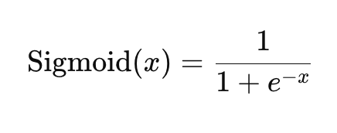
Sigmoid Activation Function
What It Does:
The Sigmoid function takes any real-valued input and squashes it into a range between 0 and 1.
Formula:
Where:
e is Euler’s number (approx. 2.718)
x is the input to the neuron
Why Use Sigmoid?
It’s good for binary classification tasks, especially in the output layer of a neural network.
It converts raw scores (called logits) into probabilities.
e.g. If output = 0.85 → model is 85% confident about the class being 1

Slide 15
Sigmoid Activation Function
What It Does:
The Sigmoid function takes any real-valued input and squashes it into a range between 0 and 1.
Formula:
Input (x) | Sigmoid(x) Output
-2 | ~0.12
0 | 0.5
2 | ~0.88
10 | ~0.99995
Negative inputs get mapped close to 0
Positive inputs get mapped close to 1
Input 0 becomes exactly 0.5

Slide 16
Sigmoid Activation Function
Drawbacks:
Vanishing gradient problem: For large positive or negative inputs, the gradient becomes very small, slowing learning.
Output not centered at zero → may slow convergence in hidden layers.
Typical Use:
Not used in hidden layers of CNNs (ReLU is better there).
Used in the final output layer for binary classification problems.
Code using kersas
from tensorflow.keras.models import Sequential
from tensorflow.keras.layers import Dense
model = Sequential()
model.add(Dense(1, activation='sigmoid')) # Output layer with sigmoid

Slide 17
What are Pooling Layers?
Pooling layers reduce the spatial dimensions (width and height) of feature maps, helping to:
Lower computation
Retain essential features
Introduce translation invariance (i.e., robustness to small shifts in input)
They operate independently on each depth channel (feature map).
Types of Pooling
(a) Max Pooling
Takes the maximum value within a defined window.
Helps retain important features like edges and textures.
Formula:
Output=max(window)
Example:
From a 2×2 window:
[[3, 5],
[1, 2]] → max = 5

Slide 18
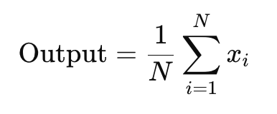
What are Average Pooling
Computes the average of values in the window.
Produces smoother outputs, but may dilute important features.
Formula:
Where:
N is the number of elements in the window (e.g., 4 in a 2×2 window)
Xi is the pixel value
[[2, 4],
[4, 6]] → avg = (2+4+4+6)/4 = 4

Slide 19
Global Pooling (Global Max or Average)
Global Pooling (either Global Max Pooling or Global Average Pooling) reduces each entire feature map to a single value per channel.
Instead of applying pooling over small regions (like 2×2 or 3×3 as in max/avg pooling), global pooling applies the operation across the entire spatial dimensions of the feature map.
Reduces entire feature map to a single value per channel.
Often used just before the output layer instead of fully connected layers (e.g., in ResNet, MobileNet).
Use Cases:
Compact models
Fewer parameters (reduces overfitting)
More interpretable
Why Use Global Pooling Instead of Dense Layers?
Advantages:
Reduces number of parameters — No trainable weights, unlike fully connected layers.
Prevents overfitting — Particularly useful for small datasets.
Improves interpretability — Easier to visualize and understand contributions of each channel.
Lightweight — Ideal for mobile/embedded devices (used in MobileNet, ResNet, etc.).

Slide 20
Global Pooling (Global Max or Average)
from tensorflow.keras.models import Sequential
from tensorflow.keras.layers import Conv2D, GlobalAveragePooling2D, Dense
model = Sequential([
Conv2D(64, (3,3), activation='relu', input_shape=(64, 64, 3)),
Conv2D(128, (3,3), activation='relu'),
GlobalAveragePooling2D(), # Instead of Flatten() + Dense
Dense(10, activation='softmax') # Classification layer
])
Comparison with Flatten + Dense
Technique | Parameters | Risk of Overfitting | Efficiency
Flatten() + Dense | High | High | Low
GlobalPooling | Zero | Low | High

Slide 21
Why Use Pooling?
Benefit | Description
Dimensionality Reduction | Reduces the size of feature maps → faster computation & fewer parameters
Translation Invariance | Helps detect features regardless of small input shifts
Reduces Overfitting | Fewer parameters → less chance of overfitting

Slide 22
Fully Connected Layers and Classification
After extracting spatial features through convolution and pooling, CNNs transition to fully connected layers for final decision-making (like classification).
Role of Fully Connected Layers
Flattening: Converts the 3D feature maps into a 1D vector.
Example: From a 5×5×16 tensor → 400-dimensional vector.
The FC layers combine all features to determine the class.
Learns complex relationships via weight matrices.
Structure of FC Layers
Component | Description
Flattening | Converts output from conv layers (e.g., 7×7×64) into a single long vector.
Dense Layers | Fully connected layers with activation functions like ReLU.
Output Layer | Uses:
Softmax for multi-class classification
Sigmoid for binary classification

Slide 23
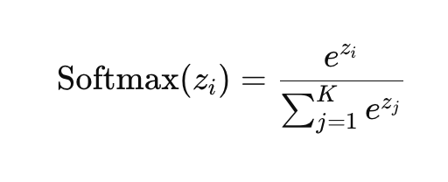
Softmax Activation (for Multi-class Classification)
Formula:
Where:
zi​: the score (logit) for class i
K: total number of classes
Purpose: Converts raw outputs (logits) into probabilities that sum to 1.
Dropout (Regularization)
During training, randomly drops a percentage of neurons in FC layers.
Prevents overfitting by forcing the network to learn redundant representations.
Common dropout rates: 0.3 to 0.5
from tensorflow.keras.layers import Dropout
model.add(Dropout(0.5))

Slide 24
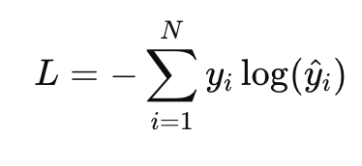
Loss Function
Cross-Entropy Loss (Used for classification):
Where:
yi: actual (true) label (1 for the correct class, 0 for others)
y^: predicted probability from softmax
This loss function penalizes incorrect predictions heavily.
from tensorflow.keras.layers import Dense, Flatten
model.add(Flatten())
model.add(Dense(128, activation='relu'))
model.add(Dropout(0.5))
model.add(Dense(10, activation='softmax')) # for 10-class classification

Slide 25
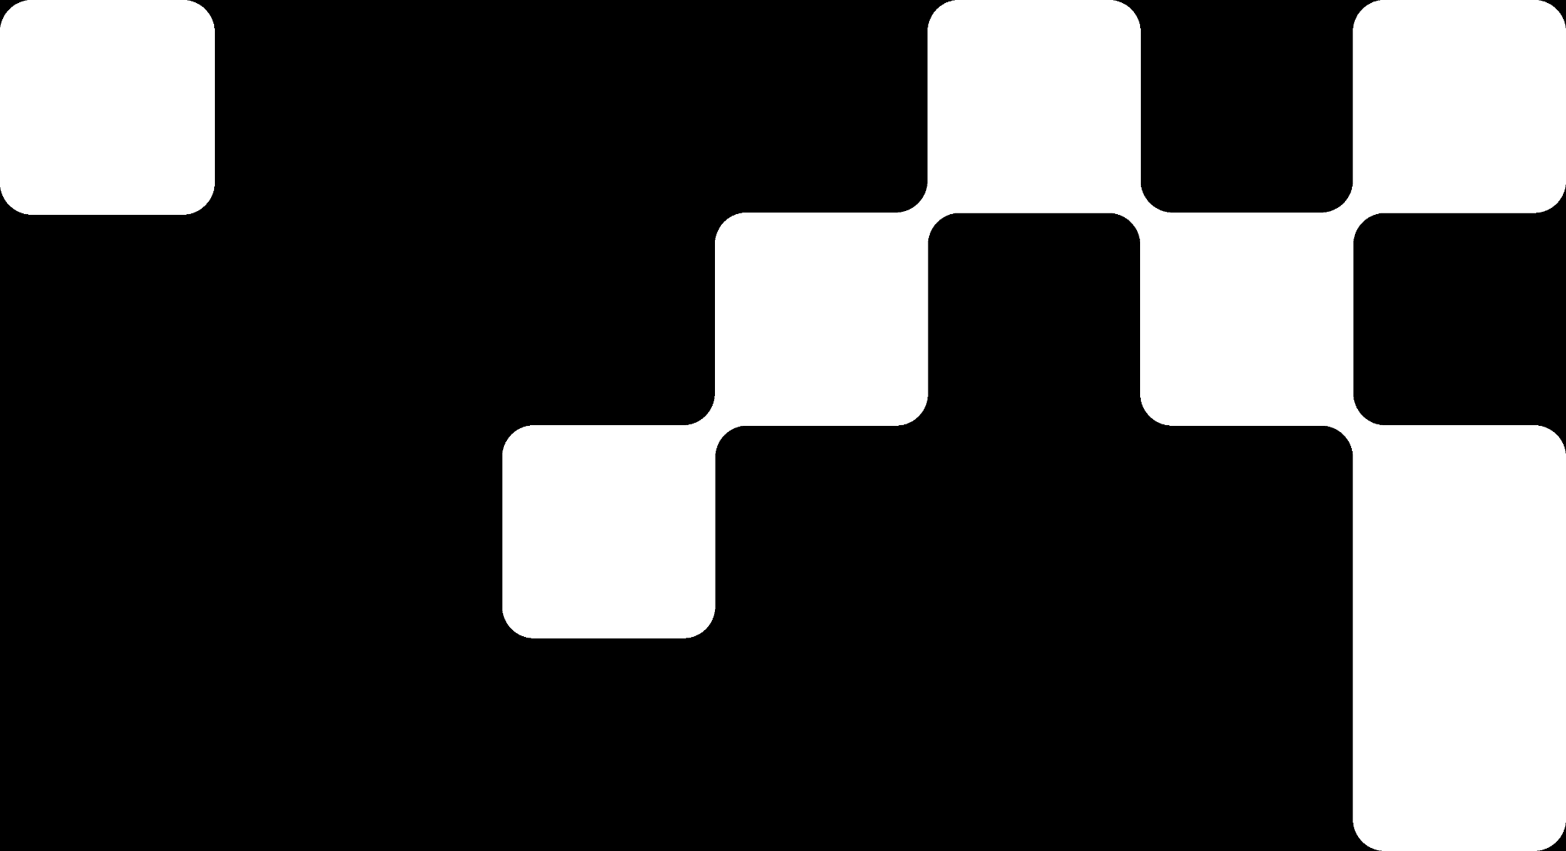
Summary
Layer Type | Purpose | Output Shape Example
Conv2D | Extract features via filters | (None, 126, 126, 32)
MaxPooling2D | Downsample spatial dimensions | (None, 63, 63, 32)
Flatten | Convert 3D to 1D | (None, 12672)
Dense (ReLU) | Hidden layer for learning combinations | (None, 64)
Dense (Softmax) | Final output layer | (None, 10)

Slide 26
Books and References
"Deep Learning" (Ian Goodfellow et al.)
"Neural Networks and Deep Learning" (Michael Nielsen)
Courses
Deep Learning Specialization (Andrew Ng, Coursera)
Fast.ai Practical Deep Learning
Datasets for Practice
MNIST (Handwritten digits)
CIFAR-10 (Image classification)
IMDB Reviews (Sentiment analysis)

Slide 27

















الشراكات العالمية

Slide 28
شــــــكــــرًا لكــــــم
THANK YOU

